Slide 1
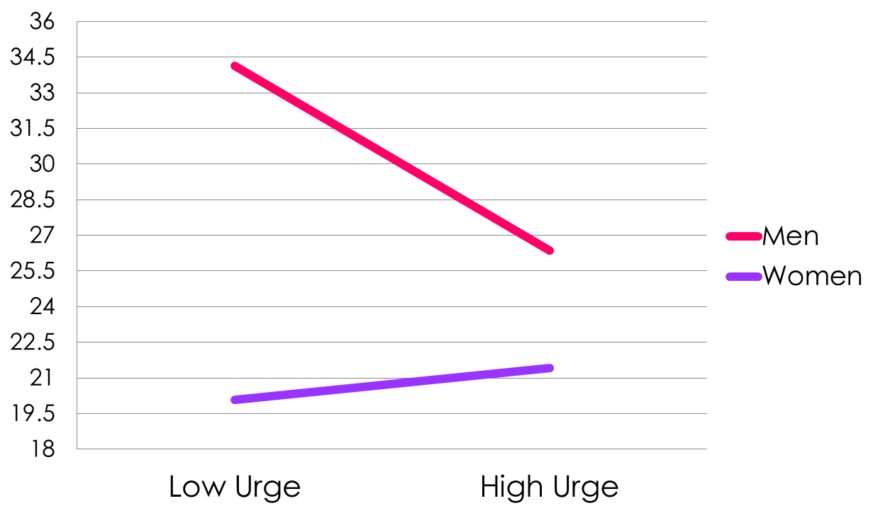
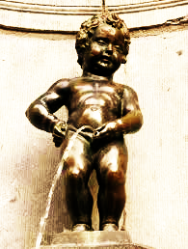
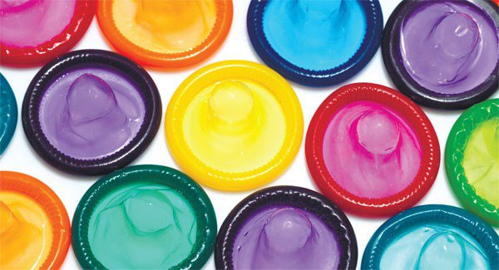
Inhibitory Spillover: Regulating Intentions to Engage in Risky Sexual Behaviors
Juwon Lee and Omri Gillath
Department of Psychology, University of Kansas
Introduction
Predictions
Intention to Engage in Risky Sexual Behaviors
Discussion
Self-control refers to the capacity to alter one’s own responses to attain goals (Vohs et al., 2014).
According to the Resource Model, self-control is based on a limited mental resource (Baumeister, Vohs, & Tice, 2007).
Once used, performance on subsequent acts involving self-control is impaired (ego-depletion; Baumeister et al., 1998).
In contrast, Inhibitory Spillover hypothesis suggests that intentional control on one task activates unintentional control in other tasks (Berkman et al., 2009).
For example, control of bodily actions could spread to unrelated domains (Tuk et al., 2010): Bladder control → Cognitive control.
The current study has two goals:
First, it pits the two alternatives mentioned above (exerting control leads to depletion vs. exerting control leads to more control in other domains).
Second, it extends the findings of Tuk et al. to decision making and control processes within close relationships, namely sexual decision making.
We tested whether increased urge to urinate and its control will lead to depletion or to inhibitory spillover.
Applying this to the sexual domain adds complexity, as the urinary and sexual systems are intricately linked:
Men: Full bladder can stimulate spinal cord and cause reflex erection (Geiger, 1979; Ricciardi, Szabo, & Poullos, 2007)
Women: Clitoral complex (Vaccaro, 2014)
Fetish subculture of Omorashi
This research suggests that the urge to urinate may increase sexual arousal, and decrease control.
Increased bladder control will either
Inhibitory spillover hypothesis: Increase sexual control; or
Depletion/Sexual arousal hypothesis: Decrease sexual control (worse decisions)
Our findings support the Inhibitory Spillover hypothesis.
Tok et al. findings held in the sexual domain, but only among men (despite no reported differences in feelings of control).
Maybe because women are lower on sexual arousal (Raffaelli & Crockett, 2003), or are more risk aversive (Buss, 2009).
Implications for Self-control:
Automatic control processes can be generalized to the sexual domain.
Resource model may still hold, as this effect may be limited to mild depletion (Vohs, Baumeister, & Schmeichel, 2012).
Limitations and Future Directions:
Our intentions to engage in risky sexual behaviors measure fits men better (Ariely & Loewenstein, 2005).
Our findings may extend to other domains within close relationships, such as withstanding temptation.
The effect of urge may be moderated by sensitivity to the Behavioral Inhibition System (Tuk et al., 2010).
Drinking a lot, needing to urinate, and controlling it, might improve decision making.
Unless it is alcohol, which can negatively affect decision making (Abbey, Saenz, & Buck, 2005; Stoner et al., 2007).
Our results suggest boosting self-control in other domains can help regulate risky behaviors.
Method
Participants: 109 college students (66 men, age_{Med} = 19)
Procedure:
In the lab, given either 50 ml (low urge condition) or 700 ml (high urge condition) of water to drink.
Engaged in a 30 min filler task
Reported degree of urge to urinate, sexual arousal, or felt control on 1-7 scale.
Completed 10 questions assessing degree of sexual control using the intentions to engage in risky sexual behaviors (adapted from Ariely & Loewenstein, 2006) ranging from 0 (no intention) to 100 (high intention) scale.
Men (M = 30.16) reported higher intention to engage in risky sexual behaviors compared to women (M = 20.76), Β = 9.4, t(107) = 4.37, p < .001.
This tendency was qualified by a 2-way interaction between urge condition and gender, Β = -9.11, t(105) = 4.23, p = .03.
Simple slopes analysis showed that among men, there was a negative slope of urge condition, Β = -7.78, t(105) = -2.36, p = .02, such that those in the high urge condition reported lower intent to engage in risky sexual behaviors.
In women, there was no difference between the urge conditions.
No effect of urge condition on intention to engage in risky sexual behaviors, sexual arousal, or feelings of control.
Risky Sexual Decision Making Questionnaire
“Would you use a condom if you did not know the sexual history of a new sexual partner?”
“Would you use a condom even if you were afraid that your partner might change their mind while you went to get it?”
Urge to urinate
Gender
Analytical approach:
Hierarchical regression analysis with urge condition (low=1, high=2), gender (women=0, men=1), and their interaction term predicting felt control, sexual arousal, urge to urinate, and intention to engage in risky sexual behaviors.
Mediation analysis using Hayes (2013) Process macro and 1000 bootstrap samples.
Urge Condition
Risky Sex
Mediational Analysis
Selected References
Results
The effect of urge condition on intention to engage in risky sexual behaviors was mediated via changes in reported urge to urinate, but only in men, Β = -4.42, 95% CI [-10.2224, -12994].
Baumeister, R. F., Vohs, K. D., & Tice, D. M. (2007). The strength model of self-control. Current Directions in Psychological Science, 16, 351-355.
Berkman, E. T., Burklund, L., & Lieberman, M. D. (2009). Inhibitory spillover: Intentional motor inhibition produces incidental limbic inhibition via right inferior frontal cortex. Neuroimage, 47, 705-712.
Botvinick, M. M., Braver, T. S., Barch, D. M., Carter, C. S., & Cohen, J. D.(2001). Conflict monitoring and cognitive control. Psychological Review, 108, 624-652.
Tuk, M. A., Trampe, D., & Warlop, L. (2011). Inhibitory spillover increased urination urgency facilitates impulse control in unrelated domains. Psychological Science, 22, 627-63
Those in high urge condition reported a greater urge to urinate, Β = 1.51, t(106) = 4.18, p < .001.
Correspondence: lee@ku.edu

