Slide 1
Intro to Psychology Research Posters PSYC 101.1

Slide 2
Main Goals of a Poster
Share your research
Attract people to your research
Get feedback on your research
Improve your resume and CV
Help network and meet other researchers with similar interests
Work closely with other researches and professor

Slide 3
Poster Layout Sections
Your Research
Introduction/Background
Method
Results
Discussion/Conclusion
Hypothesis/Predictions
References
You only want the main points from each part

Slide 4
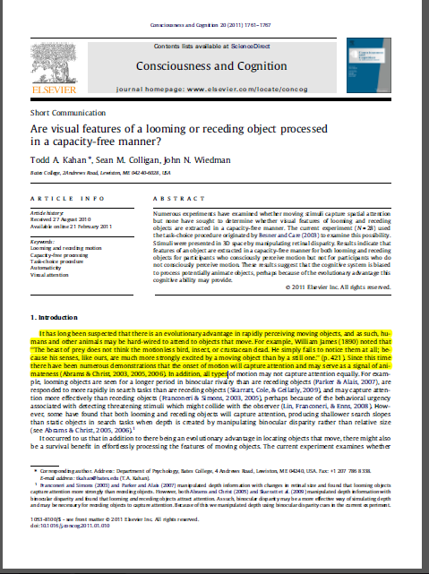
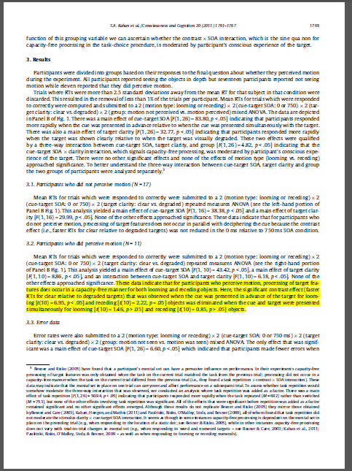
Poster Layout Sections
Pretend it is a summary of a research article!

Slide 5
Poster Layouts
Use between 2 to 4 columns

Slide 6
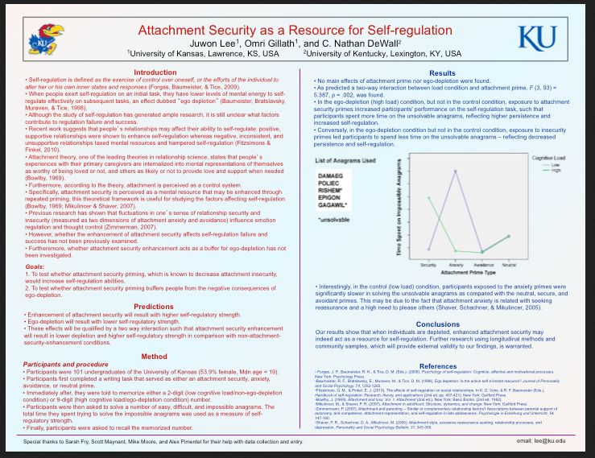

Slide 9
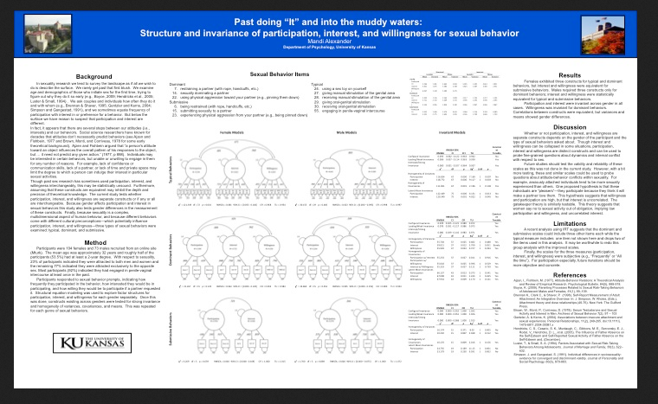
5!

Slide 10
Poster Layouts
Use between 2 to 4 columns
You want flow

Slide 13
Poster Layouts
Use between 2 to 4 columns
You want flow
Make sure to have some sort of clear divide between sections

Slide 15
Poster text
Do not want to much text
Need to leave out the unnecessary details
You can save those for talking in person

Slide 17
Poster text
Do not want to much text
Need to leave out the unnecessary details
You can save those for talking in person
Want your text to be readable from a leas a couple feet away if possible
Do not want a lot of text crammed together

Slide 18
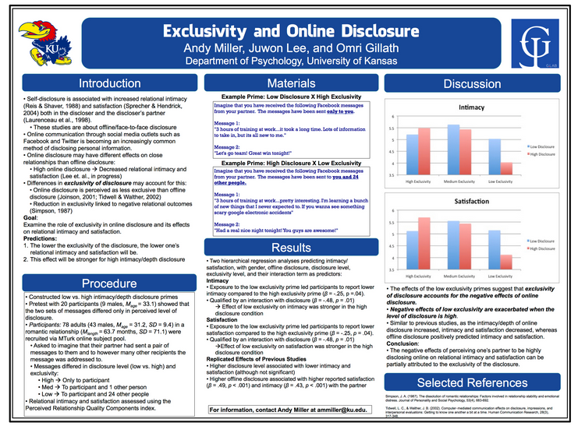
Ex: Use boxes, pictures, and graphs to separate!

Slide 19
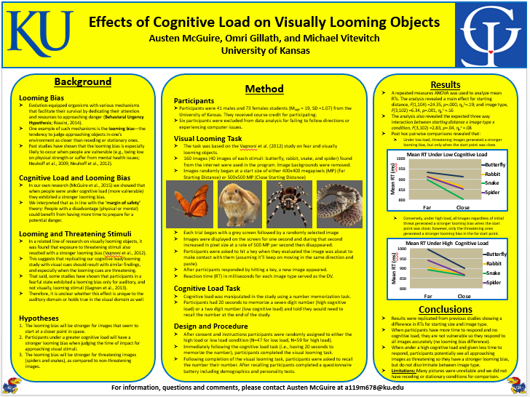

Slide 20
Visuals
Do not want too many colors unless they are used on graphs, tables, etc.
Very important because help convey a lot of information in a short amount of time

Slide 21
BAD EXAMPLE OF COLOR

Slide 22
Visuals
Do not want too many colors unless they are used on graphs, tables, etc.
Very important because help convey a lot of information in a short amount of time
Pictures can be used to helped separate text

Slide 23
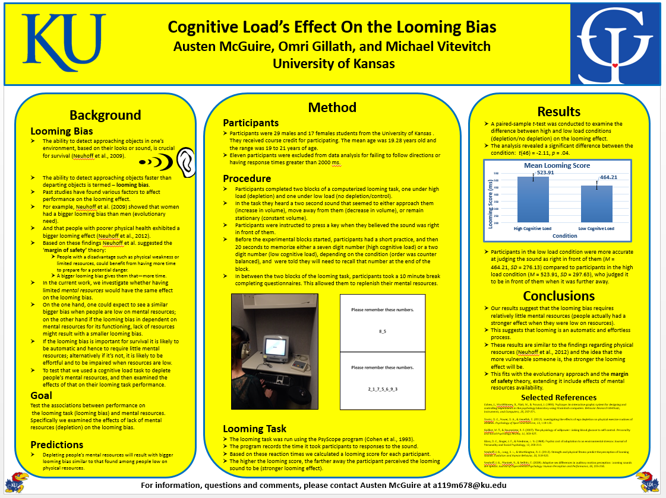

Slide 24
Visuals- Tables and figures
Keep them simple
Only include ones significant to the main points of your research
Provide legends and keys

Slide 25
Visuals- Tables and figures
BAD USE OF FIGURE

Slide 26
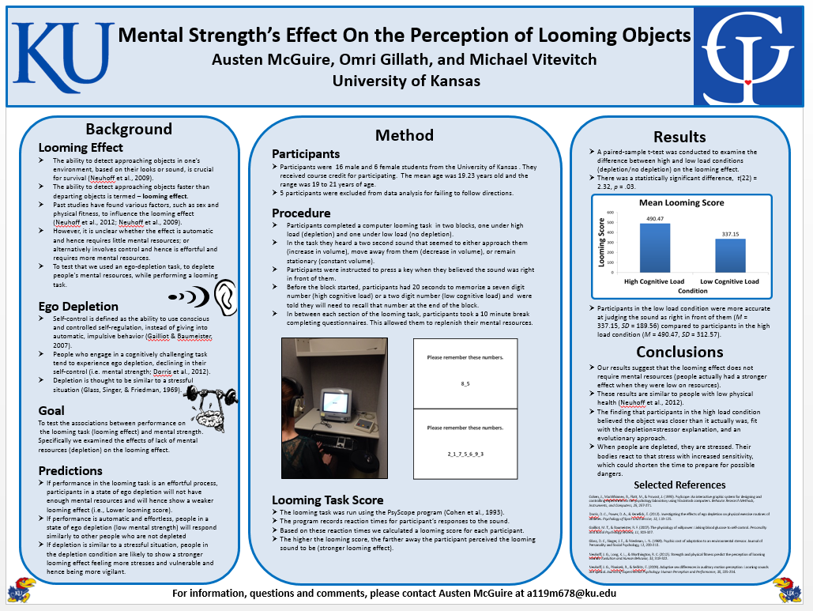
Visuals – Text color
Want it to match with other colors on the poster

Slide 27
Visuals – Text color
Want colors that help your poster pop out at people passing by
BAD
GOOD

Slide 28
Visuals – Text color
Sorry, KU colors will not work very well

Slide 29
Visuals- Fun Fact
Different colors have different effects on reading!
Black text on a red background= better memory
Black text on a blue background= more creativity
Recall words
Think creatively

Slide 30
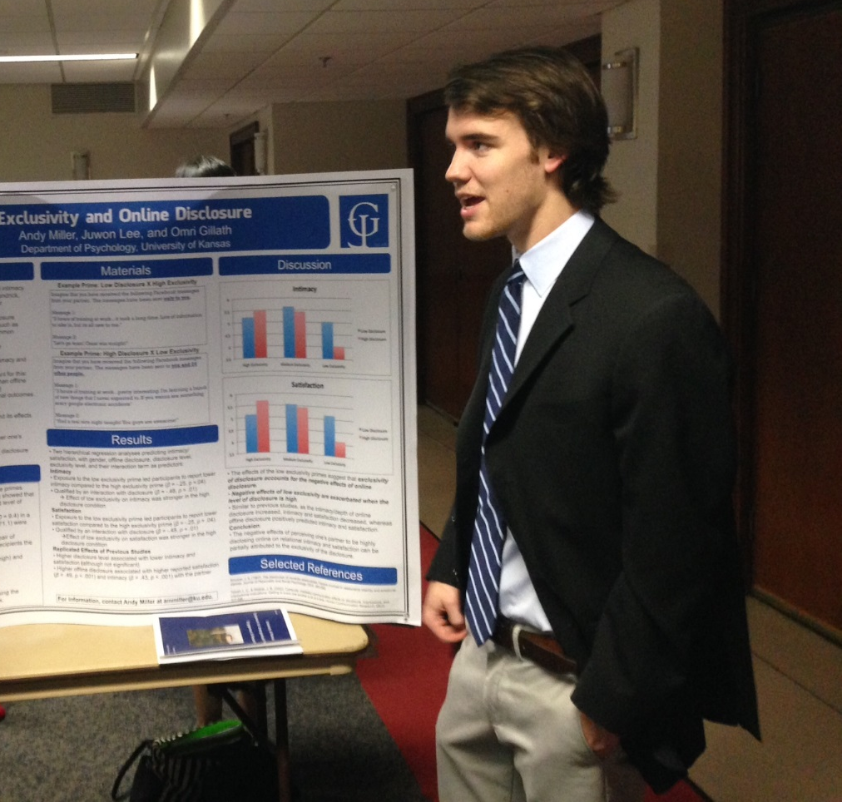
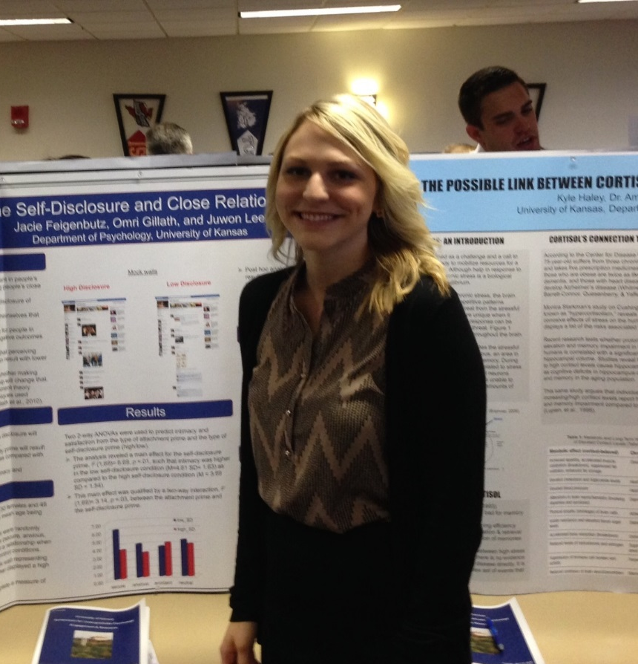
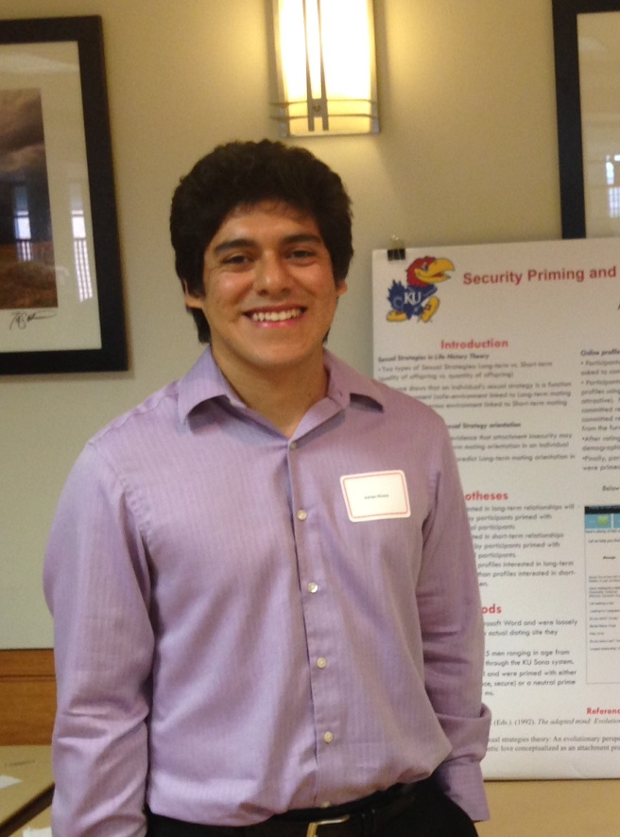
Additional Notes
Dress nice when giving a poster presentation

Slide 31
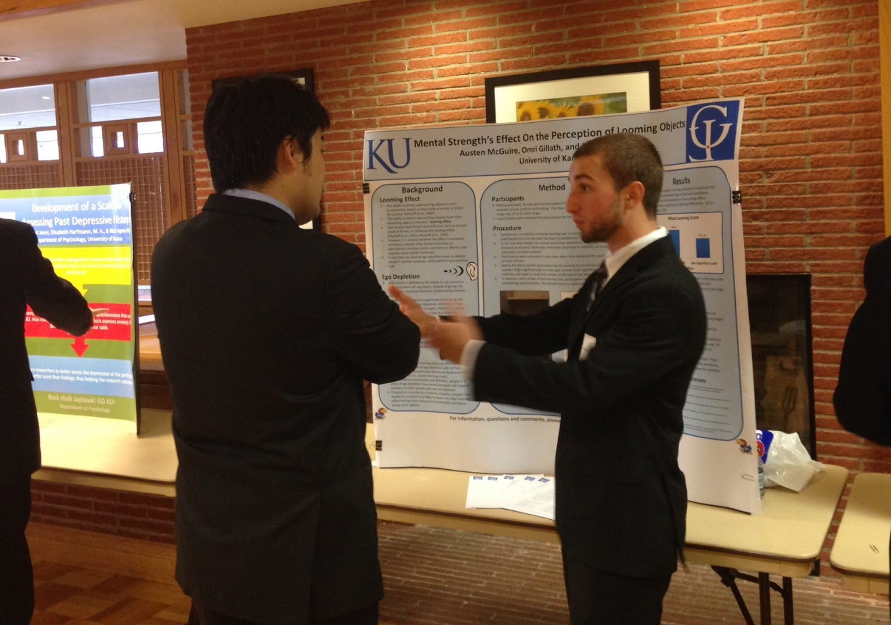
Additional Notes
Use hand motions

Slide 32
Additional Notes
Be creative and have fun!....to a point

Slide 33
Where to find additional resources
Our lab website has many poster examples
Follow the links below
http://www.ncsu.edu/project/posters/
http://people.eku.edu/ritchisong/posterpres.html
http://guides.nyu.edu/posters

Slide 34
Other Helpful Links
Link for KU logo: http://identity.ku.edu/logos/downloads.shtml
Need permission to use the Jayhawk
Check the lab website for poster examples
Gillab.ku.edu

